Slide 1

Student Name
CSE MINI PROJECT | 2026
TrustCarbon
Carbon Emission Monitoring, Analytics
& Data Integrity Platform
Student Name | UID | Department
Mohd Adil Khan
2024800056
CSE
Adtiya Chavan
2024800018
CSE
Jainam Bhavsar
2024800056
CSE

Slide 2
TRUSTCARBON
02 / 15
THE PROBLEM
Why TrustCarbon?
01 Massive datasets
02 Weak comparison
03 Hidden signals
04 Integrity gap
Thousands of emission records across countries, regions and years
Historical patterns are difficult to identify from raw numbers.
Important records should be verifiable against unauthorized modification.
Raw CSV data makes country and state comparisons difficult.
RAW DATA → LIMITED CONTEXT → LIMITED INSIGHT & TRUST

Slide 3
TRUSTCARBON
03 / 15
PIPELINE
From ingestion to verification
CSV
INGESTION
CLEAN +
NORMALIZE
COMPARE +
AGGREGATE
CHARTS +
MAPS
ANALYZE TRENDS
VERIFY
SHA-256 Integrity Check

Slide 4
TRUSTCARBON
04 / 15
PLATFORM / 02
What is TRUSTCARBON?
A web platform that turns emission datasets into interactive, verifiable insight.
1 /
2 /
ACCESS CONTROL
Country-wise and historical CO₂ analysis.
State-wise emission comparison.
OPEN Industrial emission data - no login
LOGIN Personal / user-specific data
APPROVAL Company additions verified by admin + DBA
3 /
4 /
Interactive reports
Hash integrity verification

Slide 5
TRUSTCARBON
05 / 15
FRONTEND ARCHITECTURE
Fast, modular, maintainable
01
02
03
React 19
JavaScript
Vite
Component-based UI
Logic & interaction
Development & build tool
04
05
06
React Router DOM
Recharts
CSS
Page navigation
Data visualization
Styling & responsive layout
DATA CSV / JS • QUALITY OXLINT STATIC ANALYSIS

Slide 6
TRUSTCARBON
06 / 15
SOFTWARE ENGINEERING
Composition over complexity
src/
├─ components/
│ ├─ EmissionsTrend
│ ├─ ComparisonChart
│ ├─ RegionalChart
│ ├─ DataTable
│ └─ PersonalTracker
├─ pages/ data/ utils/ styles/
└─ App.jsx
MODULAR
BY DESIGN
Reusable React components keep analytics, routing, data, and presentation concerns cleanly separated.

Slide 7
TRUSTCARBON
07 / 15
ACADEMIC MAPPING
Subject → TrustCarbon feature
DBMS
PostgreSQL storage & management
STATISTICS
Z-score & forecasting
DATA STRUCTURES
Heap & queue processing
NETWORKS
REST APIs & WebSockets
ALGORITHMS
Anomaly + graph traversal

Slide 8
TRUSTCARBON
08 / 15
DATASET & METHODOLOGY
Validated scope. Comparable records.
5,677
190
30
records
countries
years · 1990–2019
GLOBAL
INDIA STATE LEVEL
CO₂ emissions • per capita • country-wise history
CO₂ • CO • CH₄ • kg/person • validated CSV + JS

Slide 9
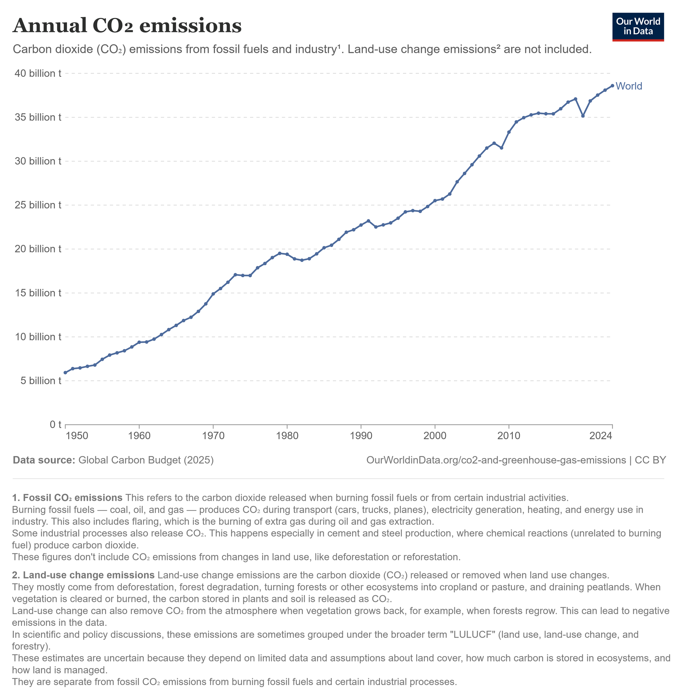
TRUSTCARBON
09 / 15
1990—2019 / GLOBAL TREND

Slide 10
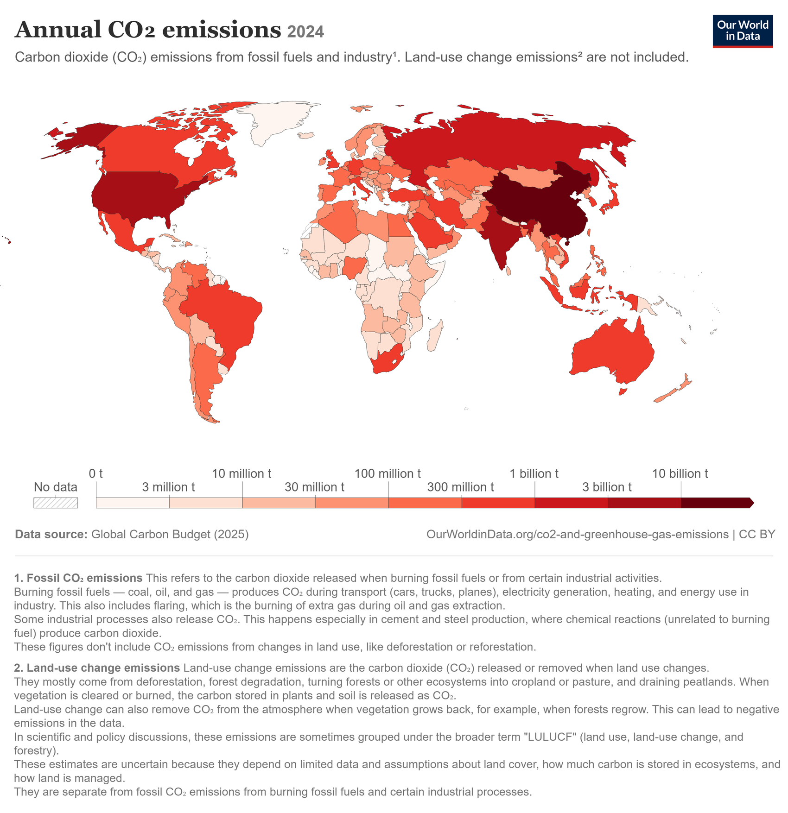
TRUSTCARBON
10 / 15
2024 DATA
GLOBAL EMISSION INSIGHTS
Heatmap of countries
1. MAJOR CONTRIBUTORS
Major industrial and energy-consuming economies account for a large share of annual CO₂ emissions.
2. REGIONAL PATTERN
Higher emissions are concentrated across major industrial regions, while lower values appear across many developing regions.
3. HOW TO READ THE MAP
Dark red → Higher CO₂ emissions
Light red → Lower CO₂ emissions

Slide 11
TRUSTCARBON
11 / 15
INDIA / STATE-WISE
CO₂ per capita · kg/person
1 GOA
1618.08
2 CHHATTISGARH
1618.08
3 PUNJAB
1618.08
4 JHARKHAND
1403.43
5 HARYANA
1381.86
TrustCarbon tracks state-wise greenhouse gas emissions, including:
  CO₂ — Carbon Dioxide
  CO — Carbon Monoxide
  CH₄ — Methane
  CO₂ per capita — kg/person

Slide 12
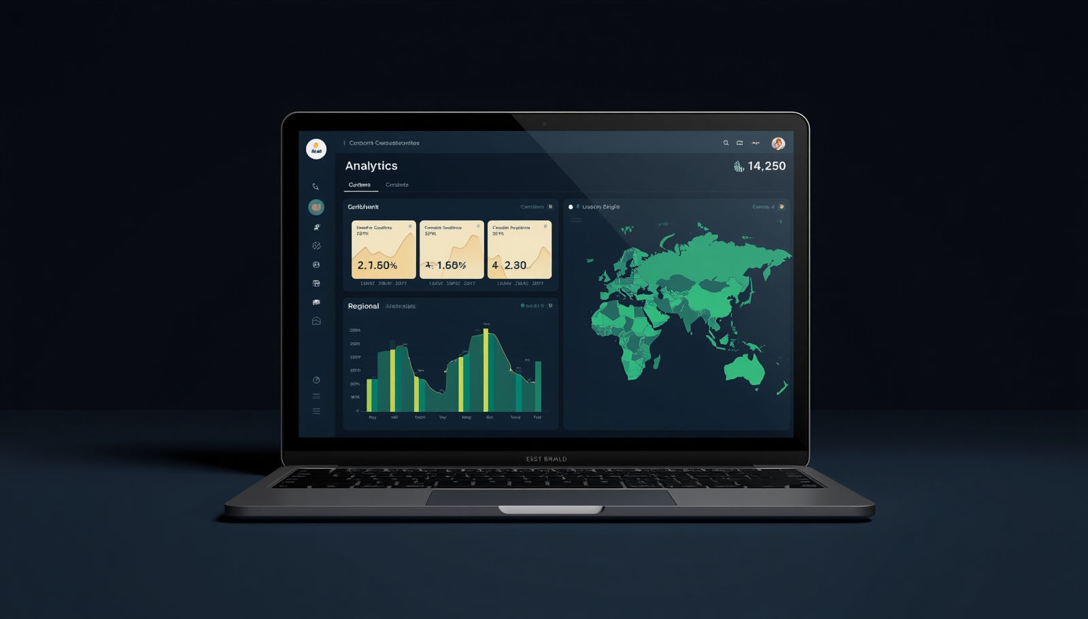
TRUSTCARBON
12 / 15
THE WORKING APPLICATION
One interface.
Four clear journeys.
HOME
DASHBOARD
ANALYTICS
PERSONAL TRACKER
Industrial: open access
Personal: login required
Company submission: admin approval

Slide 13
TRUSTCARBON
13 / 15
INSIDE THE DASHBOARD
See the signal, then inspect the record
KPI CARDS
TREND VIEW
REGIONAL CHARTS
Key metrics at a glance
Change through time
Compare places
DATA TABLES
ANALYTICS
ACCESS POLICY
Inspect detailed records
Explore interactively
Right data, right user

Slide 14
TRUSTCARBON
14 / 15
DATA INTEGRITY
Can we trust the data?
ORIGINAL RECORD
MODIFIED RECORD
SHA-256 hash matches
✓ tamper-evident
✓ verified by database administrator
SHA-256 hash mismatch
× change detected
× approval blocked
RECORD 01 8f14e45f… RECORD 02 45c48cce… RECORD 03 VERIFIED

Slide 15
TRUSTCARBON
15 / 15
PROJECT OUTCOMES
From raw emissions to trusted insight
BUILT
Interactive dashboard
Global + India analysis
Historical trends
Hash-based integrity
NEXT
Real-time APIs
ML forecasting + anomalies
Blockchain verification
Carbon credit tracking
Turning emission data into understandable
and verifiable information.
THANK YOU / QUESTIONS

